Slide 1
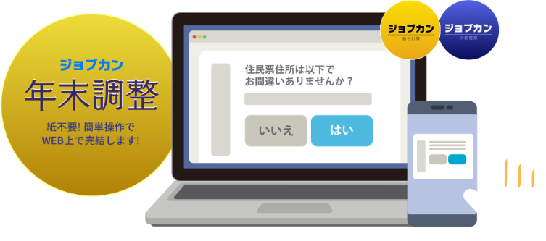
ジョブカン年末調整の使い方
【従業員向けマニュアル】
株式会社 DONUTS ジョブカン年末調整
【東京本社】 〒151-0053 東京都渋谷区代々木2-2-1 小田急サザンタワー8F
【その他国内拠点】札幌オフィス、秋田オフィス、新潟オフィス、京都オフィス、大阪オフィス、高知オフィス、福岡オフィス
Notes:
å

Slide 2
For Group Manager, How to Use this Manual
This is the “Jobcan Year-end Tax Adjustment” manual for staff.
In addition to operational guidance, this manual also provides information on advance preparations, and the explanation is based on the standard usage of the system.
This instructions is based on standard usage.
The way of using “Jobcan Year-end Tax Adjustment” differs depending on the company so
feel free to edit this manual.
We hope this will help reduce your work related to year-end tax adjustment.

Slide 3
Contents
■ Schedule of the Year-end Tax Adjustment
■ Advance Preparations of the Year-end Tax Adjustment
■ How to Use “Jobcan Year-end Tax Adjustment”
1. Access to the questionnaire form
2. Answer to the questionnaire
3. Accept requests to modify
4. Check the withholding tax certificate
■ Frequently Asked Questions

Slide 4
Schedule of the Year-end Tax Adjustment
Year-end tax adjustment is an important procedure for the company to carry out your final return on your behalf.
This year’s schedule will be as follows, so please keep to this deadline.
■Share the questionnaire form with staff
●/●
■The deadline to submit the questionnaire form to manager
●/●
■The deadline for submitting documents that require the original submission
●/●
* Documents that require the original submission
・ ◎◎◎◎
・ ◎◎◎◎
・ ◎◎◎◎
The place of submission : _______Box
Notes:
御社の実施日程、実施内容に合わせた記載にご変更くださいませ。

Slide 5
Advance Preparations of the Year-end Tax Adjustment
The year-end tax adjustment for this year will be carried out using the questionnaire form from the “Jobcan year-end tax adjustment” system.
Questionnaire responses are automatically saved and can be interrupted.
We recommend you to check the information and materials required to fill out the form in advance.
【 Required information / materials】
■ Mid-career workers ・ "Withholding tax statement of salary income" of the previous job who received payment after January 1st, this year
*Original submission required / If submitted at the time of joining the company, you don’t need to resubmit
■ Persons who receive a working student deduction or a disability deduction
・ Working student: Documents certifying that the student is a working student (copy of student ID card, etc.)
* Submission required
(students with salary income of 1.3 million yen or less. Details : https://www.nta.go.jp/taxes/shiraberu/taxanswer/shotoku/1175.htm）
・Persons who receive a disability deduction: Disability certificate
■ Those who receive spouse deduction or special spouse deduction
・ Spouse income statement
■ Those who receive dependent deductions for relatives living abroad
・ Documents related to relatives (copy of family register, copy of passport, etc.)
・ Certificate of remittance to dependents with different addresses
・ Certificate of studying abroad (Applicable from 2023 January. Details https://www.nta.go.jp/taxes/tetsuzuki/shinsei/annai/gensen/kokugai/index.htm )

Slide 6
Advance Preparations of the Year-end Tax Adjustment
■Those who have insurance ・Certificate of deduction for Life insurance premiums *Original submission required
・Certificate of deduction for Damage insurance premiums *Original submission required
・Certificate of deduction for Social insurance premiums(or receipt) *If you are paying the National Pension Insurance premium, you must submit the original
・Receipt of National Health Insurance premium
■Those who are paying premiums ( mutual aid for small businesses etc. )
・Certificate of payment of premium, etc. *Original submission required
■ Those who receive a mortgage deduction (after the second year)
・ Special deduction report for housing loans, etc. * Original submission required
・ Certificate of loan balance, etc. related to housing acquisition funds * Original submission required
The time it takes to answer the year-end adjustment questionnaire will vary depending on the insurance coverage and the presence or absence of dependents.
(It will take around 20mins If you have insurance and dependents.)
We kindly ask for your reply by the deadline.

Slide 7
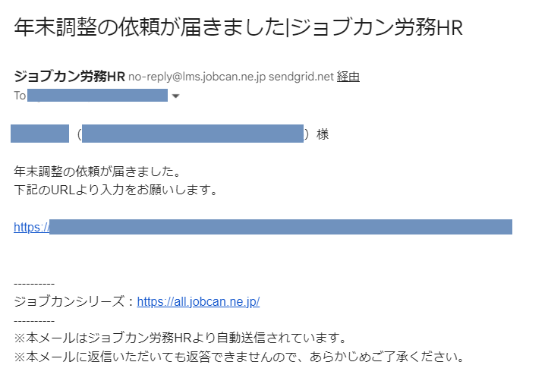
How to Use “Jobcan Year-end Tax Adjustment”
☑Access to the questionnaire form
“A request for year-end adjustment has arrived : Jobcan”
“A request for year-end adjustment has arrived : Jobcan”
【STEP1】
You will receive an email with the title “A request for year-end adjustment has arrived”.
Check the contents and click the URL written on the email.

Slide 8
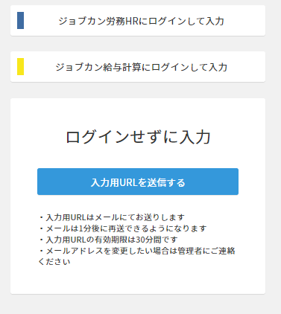
How to Use “Jobcan Year-end Tax Adjustment”
☑Access to the questionnaire form
【STEP2】
When you click the URL in the email,
if you have a My Page
←The screen will appear as the example on the left
If you can log in to My page of Jobcan labor management or Jobcan Payroll, click “Login and enter” to log in
If you cannot log in to My page, click “Send URL for input” at the bottom, then access the questionnaire form from the URL on the email you received again
Login to Jobcan labor management
Login to Jobcan Payroll
The screen after login
There is a request for Year-end Tax Adjustment

Slide 9
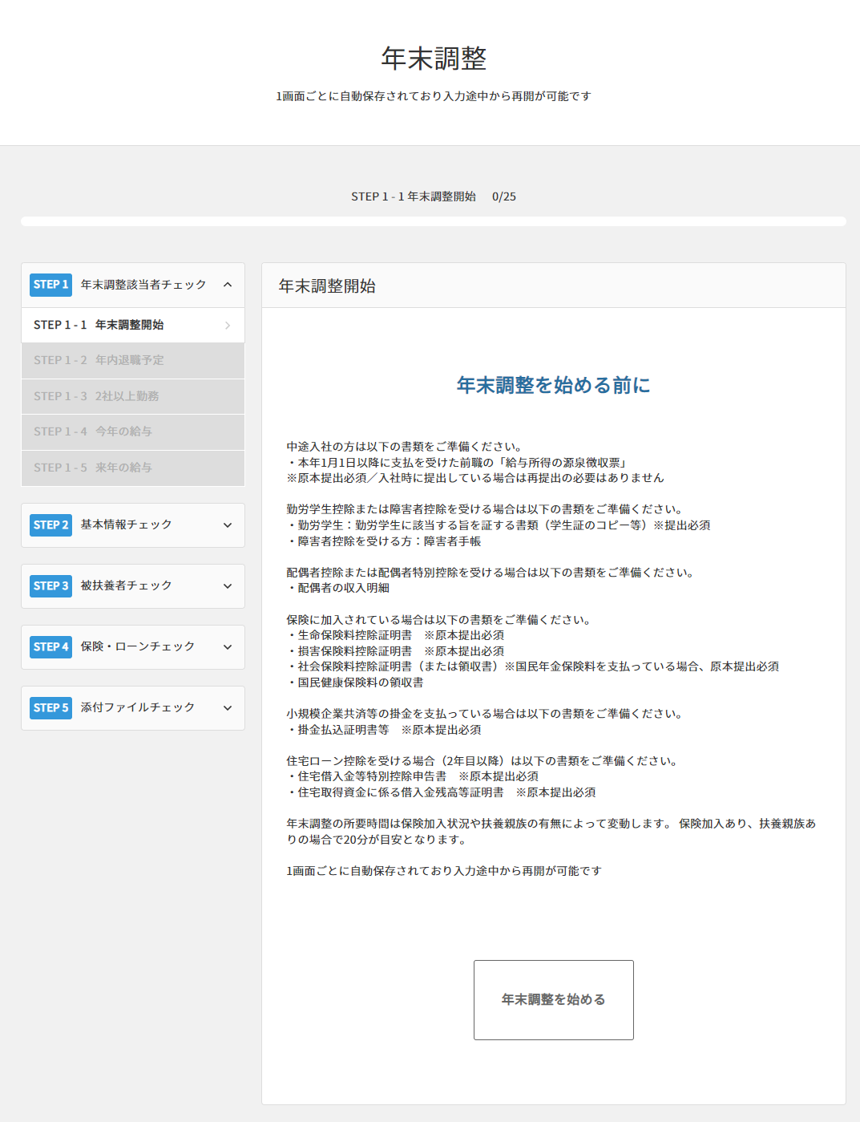
How to Use “Jobcan Year-end Tax Adjustment”
☑ Answer to the questionnaire
The Jobcan system is only available in Japanese.
If you cannot read Japanese we recommend using screen translate (Google translate etc.) to make your work easier.
【STEP1】
When you access the input form,
←The screen will look like the example on the left
Check the document and information that need to be submitted, Click “start year-end adjustment”.
*Even if you don’t know/remember the content to be entered, you can close the screen in the middle of input and re-open.
The input screen will be displayed again and you can restart to fill out from the middle.
Start Year-end Tax Adjustment

Slide 10
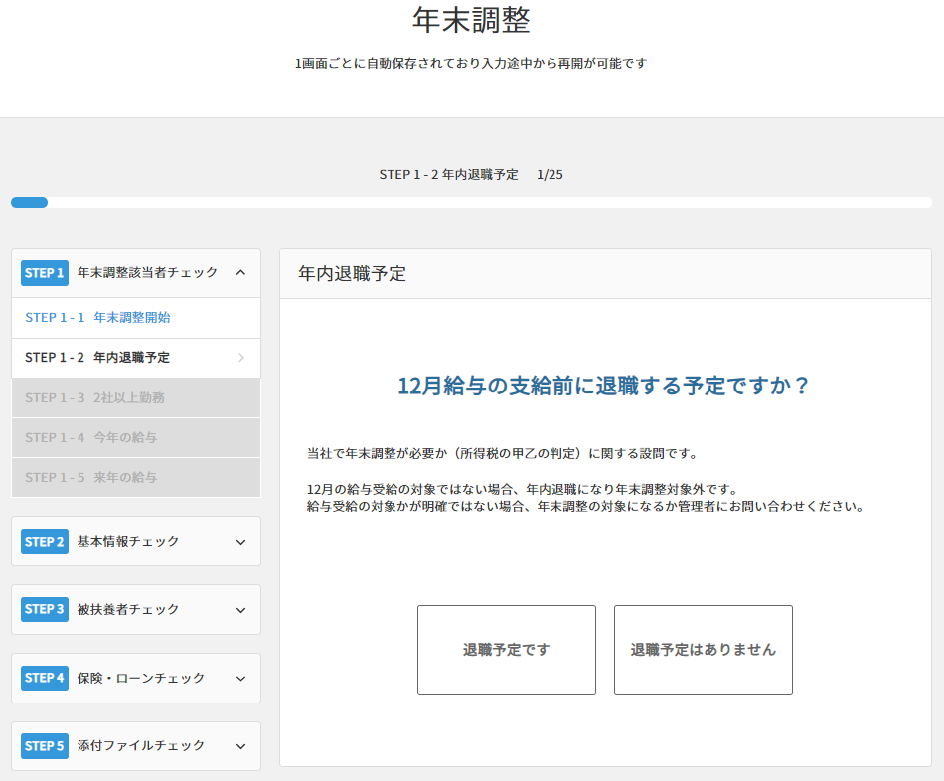
How to Use “Jobcan Year-end Tax Adjustment”
☑ Answer to the questionnaire
【STEP2】
When you start the year-end tax adjustment,
the questions will start as shown on the left.
STEP1 is to check if you are applicable for our year-end tax adjustment at our company.
Select the appropriate answer and proceed to enter information/answers.
The questions are as follows.
Do you plan to resign before your December salary is paid?
Do you currently work for more than one company?
(If you are, in principle, the company with the higher salary will handle the year-end tax adjustment)

Slide 11
How to Use “Jobcan Year-end Tax Adjustment”
☑ Answer to the questionnaire
STEP2 is to check your general information required for the year-end tax adjustment.
※For those who have adjustments in the personal information, please adjust the already registered information.
The questions are as follows.
Personal information / Registered address of resident
Information of householder
Information of previous job
Salaray income, etc.
Working students (if applicable)
Disability classification
Martial status

Slide 12
How to Use “Jobcan Year-end Tax Adjustment”
☑ Answer to the questionnaire
STEP3 is to check the existence of
dependents and their information
* Please check your spouse income information (such as the total income of your spouse) in advance.
The questions are as follows,
Confirmation of spouse deduction / special spouse deduction →If applicable, spouses income information is required for input.
Confirmation of tax dependent relatives →If applicable, you will be required to enter dependent’s information.

Slide 13
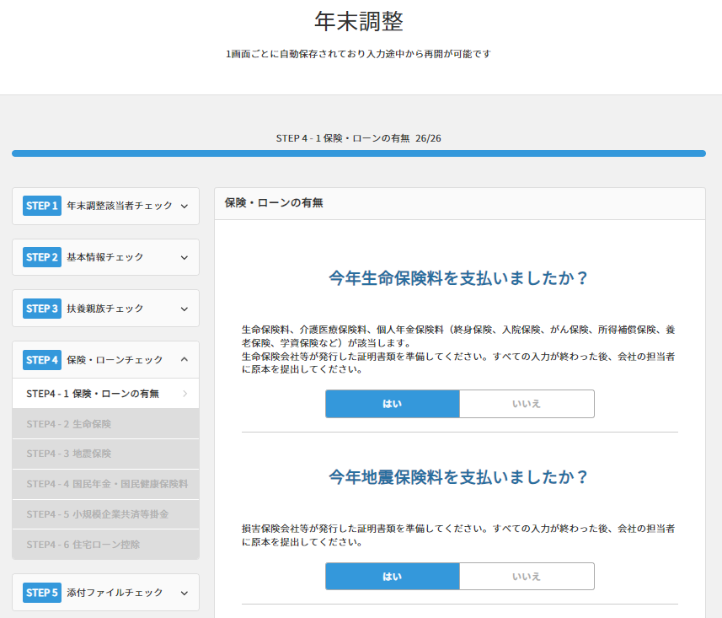
How to Use “Jobcan Year-end Tax Adjustment”
☑ Answer to the questionnaire
STEP4 is to confirm insurance / loan information
The contents to be confirmed are are as follows
・ Life insurance
・ Earthquake insurance
・ National pension / National Health
Insurance premium
・ Mutual aid contract premium /
individual corporate pension premium
・ Mortgage deduction
If you have a premium payment or mortgage deduction declaration, contents for entering information about each insurance will be displayed
*If there are any documents(deduction certificate etc.) you need to hand out the original copy, please don‘t forget to hand it in to ●●.

Slide 14
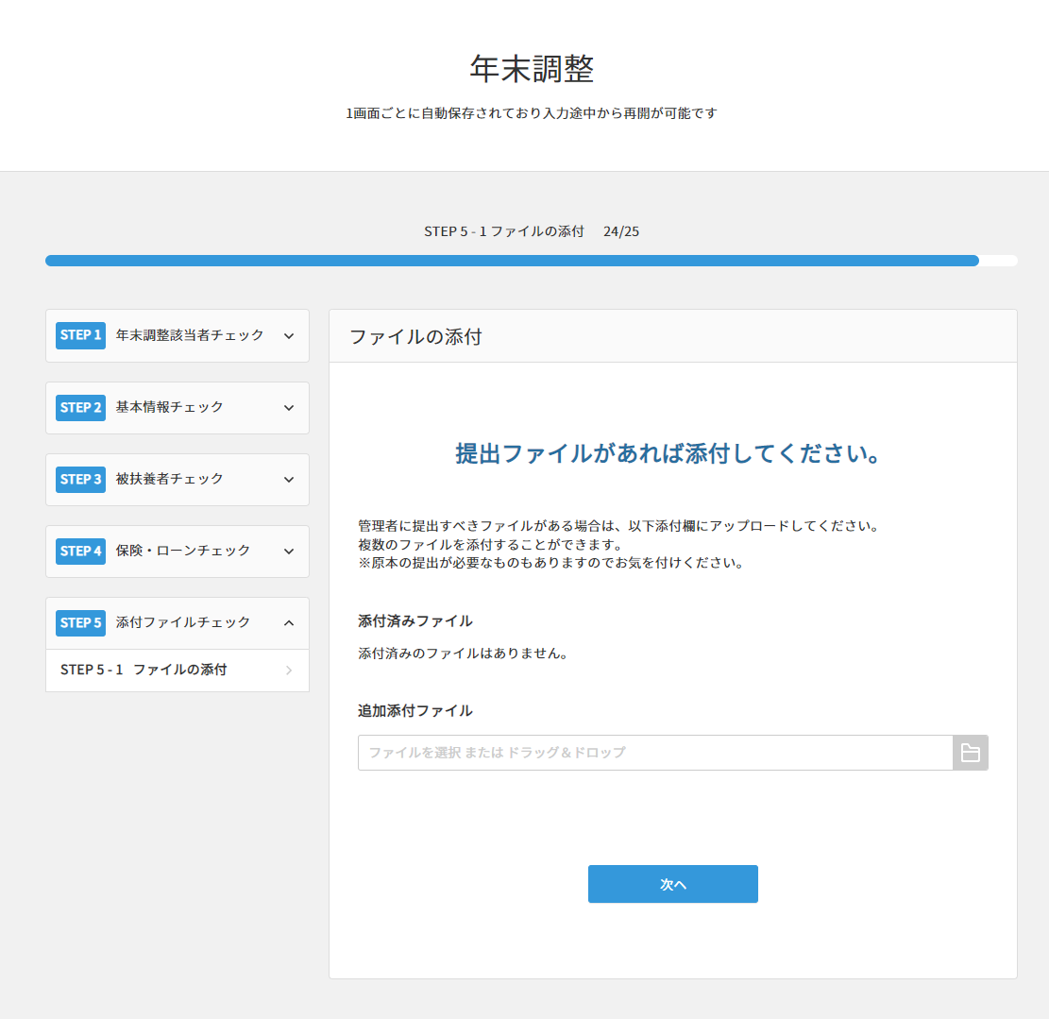
How to Use “Jobcan Year-end Tax Adjustment”
☑ Answer to the questionnaire
STEP5 is to attach the document file
If you have documents that you need to submit to manager, attach the file and click “Next”（次へ）
Next

Slide 15
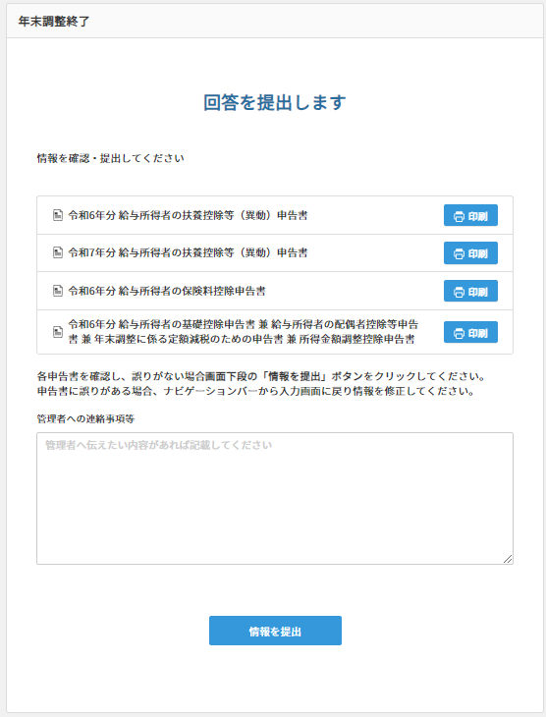
How to Use “Jobcan Year-end Tax Adjustment”
☑ Answer to the questionnaire
When you finish answering all questionnaire, the screen will change to “Submit the Answer” （“回答を提出します”）
You can check the documents by clicking them It is also enter the comments in the text box (“Contacting the administrato, etc.)
If the content of te document is correct, click “Submit the Information(情報を提出)” at the bottom.
Submit the Answer
Submit the Information

Slide 16
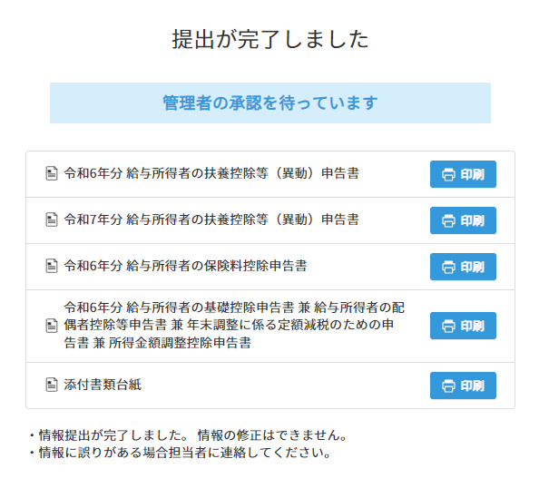
How to Use “Jobcan Year-end Tax Adjustment”
☑ Answer to the questionnaire
After submitting your answer, the screen will change as follows.
If you need to submit the paper documents, please click the name of each document to print it.
For documents you need to submit (deduction certificates etc. ) , please print the “Attachment Mount” and attach them to it.
Please print out the “Attachment Form” and affix it to deduction certificates etc. that you need to submit.

Slide 17
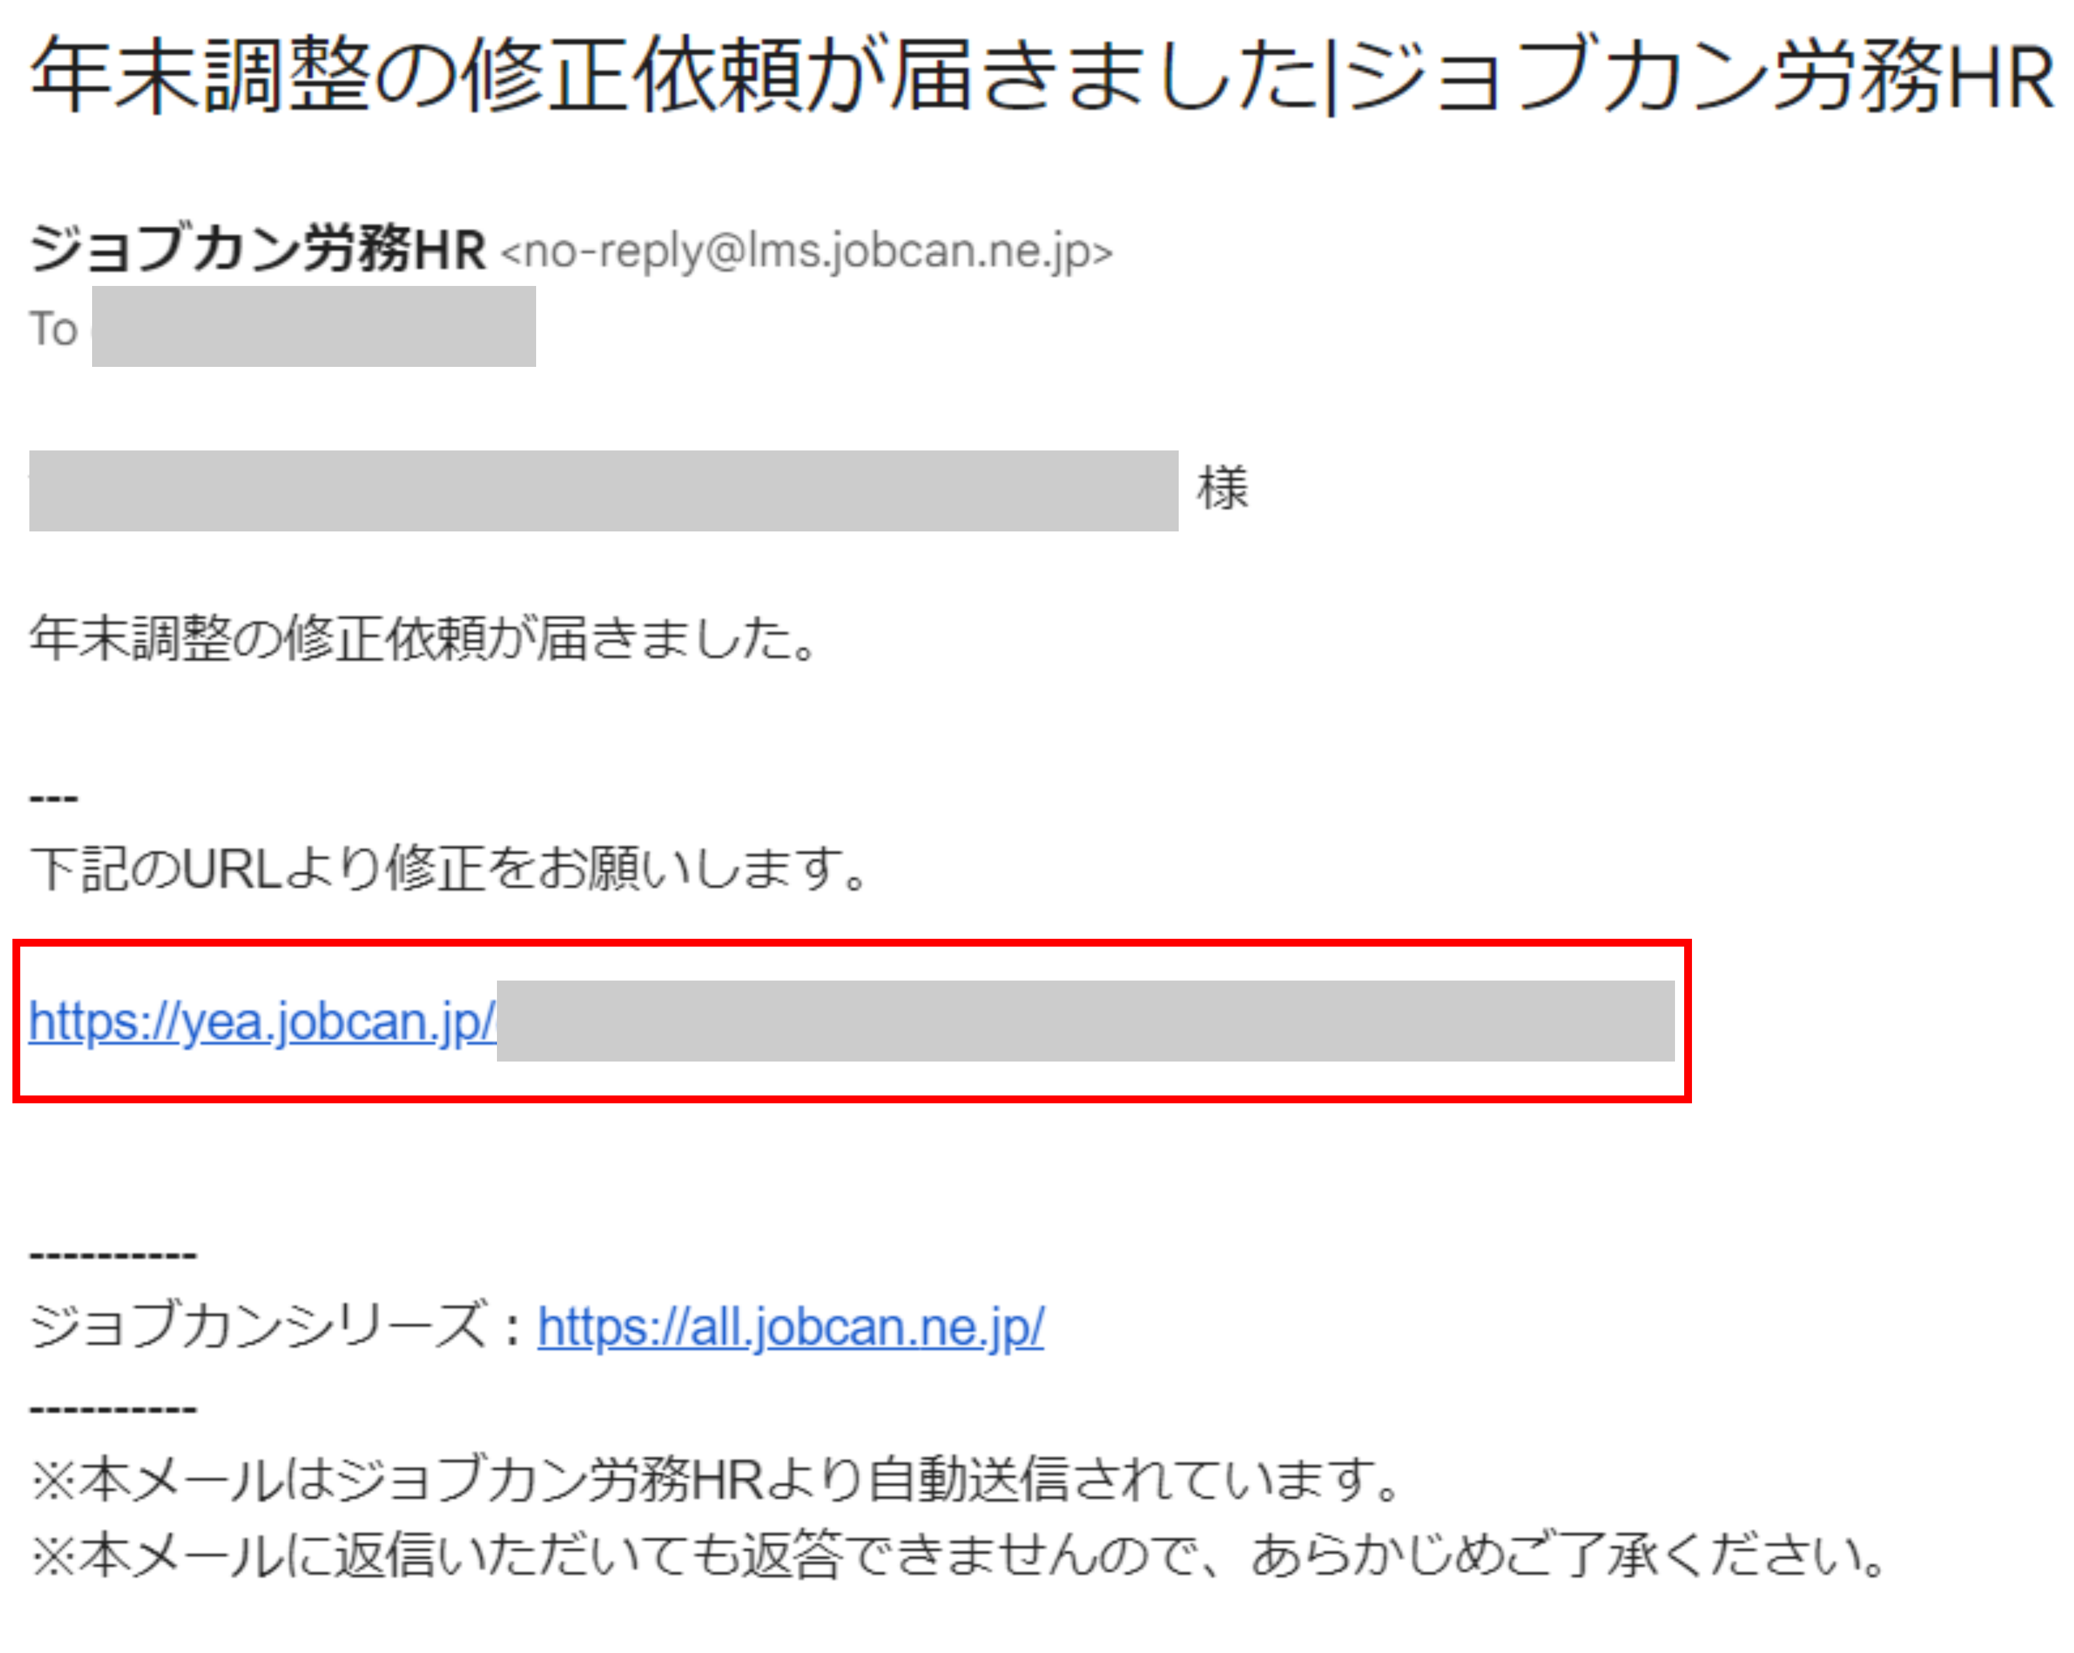
How to Use “Jobcan Year-end Tax Adjustment”
☑ Answer to the questionnaire
“A request for error correction of
year-end tax adjustment has arrived : Jobcan”
You may receive a error correction request from the group manager.
You will receive an email with the title “A request for error correction of year-end tax adjustment has arrived” (年末調整の修正依頼が届きました）.Check the comments for the error corrections.
Click the URL in the email and select whether to log in again by yourself or send the input URL by email to access the survey form.

Slide 18
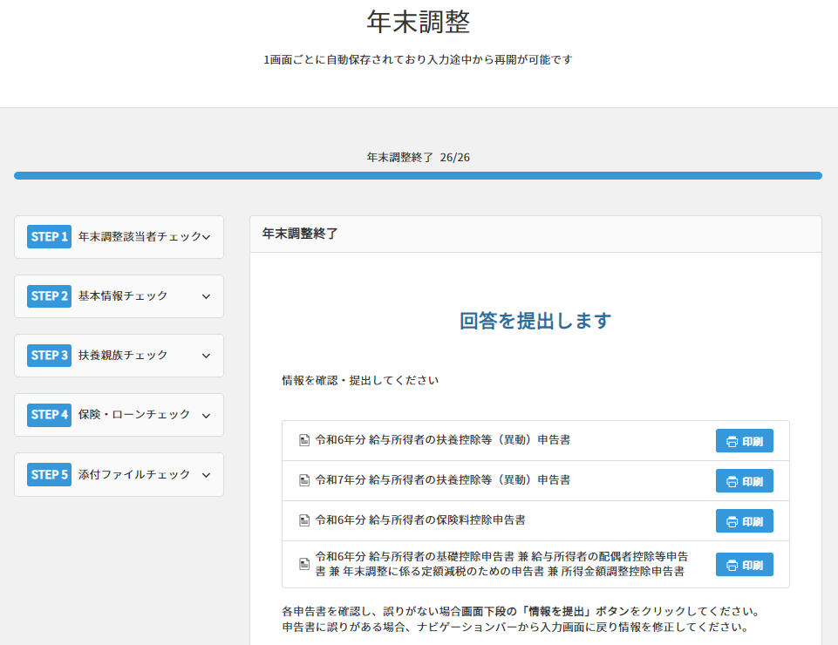
How to Use “Jobcan Year-end Tax Adjustment”
☑Accept requests to modify
If you access the resubmission, the final screen of survey form will be displayed as the example to the left
Click the “STEP” tab on the left to open the edit screen for each item and make corrections
After error corrections, complete the resubmission. Please wait for the approval of the administrator.

Slide 19
How to Use “Jobcan Year-end Tax Adjustment”
☑check the withholding tax certificate
Once the year-end tax adjustment is completed, a withholding certificate will be distributed after December. It will be distributed by one of the following method from Jobcan
(1) Distributed by email
You will receive two emails with the withholding tax PDF attached and the password.
(2) Delivered to My Page
You can check it by logging in to My Page of Jobcan Labor Management / Jobcan payroll.
The following notification will be displayed, so click it to check.

Slide 20
Frequently Asked Questions
Q： I submitted with the wrong information. Can I fix it?
A : Once the answer is submitted, it cannot be corrected by the staff.
Please contact the person in charge in the company.
Q: Can I answer from my smartphone or feature phone instead of a PC?
A : You can answer from your smartphone. Also, you can access from
the feature phone if it has installed Android. If you don’t have a device
that you can answer, please ask the person in charge in your company.
Q : I haven’t received the questionnaire input request email. What should I do?
A : The questionnaire input request email will be delivered from either of the
following addresses. [ no-reply@lms.jobcan.ne.jp / noreply@payroll.donuts.ne.jp ]
Please check if it is sorted to the junk mail folder, and if you cannot find it,
contact the person in charge in your company.
Contact
* please fill the information of the person in charge of tax-year end adjustment process
___Department____ Email:_____________ TEL:___________

