Slide 1
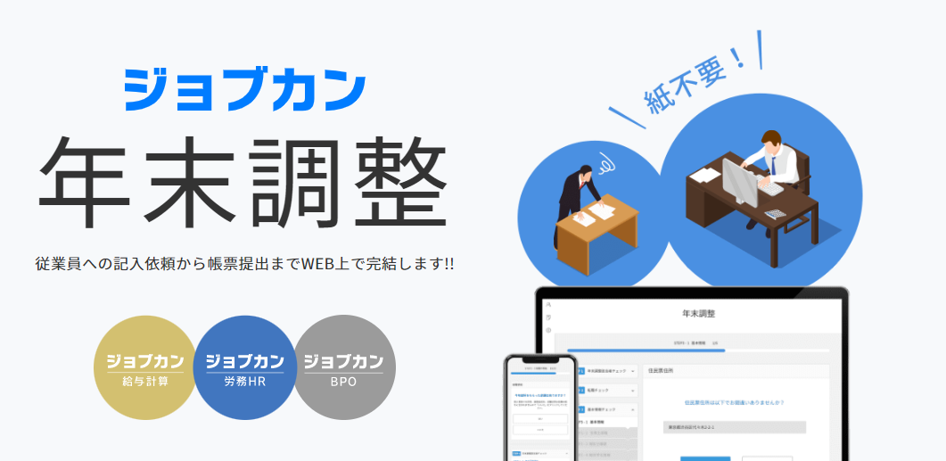


FY2025
情報セキュリティマネジメントシステムに関する国際標準規格「ISO/IEC 27001:2013／JIS Q 27001:2014」の要求事項および「ISO/IEC 27017:2015」に基づくISMSクラウドセキュリティ認証に関する要求事項(JIP-ISMS517-1.0)に適合。

Slide 2
For Group Manager, How to Use this Manual
This is the “Jobcan Year-end Tax Adjustment” manual for staff.
In addition to operational guidance, this manual also provides information on advance preparations, and the explanation is based on the standard usage of the system.
This instructions is based on standard usage.
The way of using “Jobcan Year-end Tax Adjustment” differs depending on the company so feel free to edit this manual.
We hope this will help reduce your work related to year-end tax adjustment.

Slide 3
Contents
☑ Schedule of the Year-end Tax Adjustment
☑ What is Year-end Tax Adjustment?
☑ Before Starting Year-end Tax Adjustments (preparation before input)
☑ Explanation of Each Survey Question
☑ Flow After Completing the Survey
（How to handle correction requests, how to verify withholding tax statements, etc.）
☑ Frequently Asked Questions About Employee Surveys

Slide 4
Contents
☑ Schedule of the Year-end Tax Adjustment
☑ What is Year-end Tax Adjustment?
☑ Before Starting Year-end Tax Adjustments (preparation before input)
☑ Explanation of Each Survey Question
☑ Flow After Completing the Survey
（How to handle correction requests, how to verify withholding tax statements, etc.）
☑ Frequently Asked Questions About Employee Surveys

Slide 5
To Administrators: How to Use This Manual
Year-end tax adjustment is an important procedure for the company to carry out your final return on your behalf.
This year’s schedule will be as follows, so please keep to this deadline.
■Share the questionnaire form with staff
●/●
■The deadline to submit the questionnaire form to manager
●/●
■The deadline for submitting documents that require the original submission
●/●
* Documents that require the original submission
・ ◎◎◎◎
・ ◎◎◎◎
・ ◎◎◎◎
The place of submission : _______Box

Slide 6
Contents
☑ Schedule of the Year-end Tax Adjustment
☑ What is Year-end Tax Adjustment?
☑ Before Starting Year-end Tax Adjustments (preparation before input)
☑ Explanation of Each Survey Question
☑ Flow After Completing the Survey
（How to handle correction requests, how to verify withholding tax statements, etc.）
☑ Frequently Asked Questions About Employee Surveys

Slide 7
What is Year-end Tax Adjustment?
The employer calculates income tax based on the total wages paid to employees over the year, settles any overpayment or underpayment of income tax already withheld, and finalizes the income tax liability for that year.
Monthly income tax amount
Income tax amount relative to total annual income

Slide 8
Individuals Subject to Year-end Tax Adjustments
In principle, this applies to employees receiving wages. There are exceptions for certain individuals who are not subject to year-end tax adjustments.
Excluded individuals（※examples）
Individuals retiring within the year or planning to retire within the year (scheduled to retire before the December salary is paid)
Individuals receiving wages from two or more employers who have not submitted a “Dependent Deduction Declaration Form”
Individuals whose annual salary exceeds 20 million yen
Individuals affected by disasters who have received withholding tax deferrals or refunds

Slide 9
Year-End Adjustment Schedule
October
November
December
January
ｃ
Preparing the Tools
Notification to Employees
Tax Return Document Review
Submission of Documents to Government Offices
Conduct Information Gathering Among Employees
Actuarial
Surplus or Deficit
Manager
ｃ
employee
Response to Deduction Declaration Forms
Receipt of Withholding Statement
Verification of Surplus or Deficit
Following the above process, the annual income tax is finalized, refunds or collections are made to employees, and the tax is reported to the government.

Slide 10
Contents
☑ Schedule of the Year-end Tax Adjustment
☑ What is Year-end Tax Adjustment?
☑ Before Starting Year-end Tax Adjustments (preparation before input)
☑ Explanation of Each Survey Question
☑ Flow After Completing the Survey
（How to handle correction requests, how to verify withholding tax statements, etc.）
☑ Frequently Asked Questions About Employee Surveys

Slide 11
Before Starting Year-end Tax Adjustments
Target individuals | Required documents
Mid-career workers | "Withholding tax statement of salary income" of the previous job who received payment after January 1st, this year *If submitted at the time of joining the company, you don’t need to resubmit
Persons who receive a working student deduction or a disability deduction | ・Working student: Documents certifying that the student is a working student (copy of student ID card, etc.) ・Persons who receive a disability deduction: Disability certificate※Individuals attending designated schools, etc., must submit: ① A copy of the certificate proving that the school, etc., meets certain requirements. ② A certificate proving that the individual is a student or trainee enrolled in the course described in ①.
Those who receive spouse deduction or special spouse deduction | Spouse income statement
Those who have insurance | ・Certificate of deduction for Life insurance premiums * ・Certificate of deduction for Damage insurance premiums * ・Certificate of deduction for Social insurance premiums(or receipt) * *If you are paying the National Pension Insurance premium, you must submit the original ・Receipt of National Health Insurance premium
Those who are paying premiums ( mutual aid for small businesses etc. ) | Certificate of payment of premium, etc.*
Those who receive a mortgage deduction (after the second year) | ・Special deduction report for housing loans, etc.* ・Certificate of loan balance, etc. related to housing acquisition funds*
Those who receive dependent deductions for relatives living abroad | ① Documents related to relatives （For overseas relatives of international students, in addition to “family relationship documents,” “study visa documents” are required.） ②Money Transfer Documents （When claiming the dependent deduction for an overseas relative who qualifies as “a person receiving 380,000 yen or more in payments from the taxpayer during the current year for living expenses or educational expenses,” the “380,000 Yen Remittance Documentation” must be submitted.
Documents marked with an asterisk (*) require submission of the original.

Slide 12
Before Starting Year-end Tax Adjustments
対象者 | 必要な書類
Mid-career workers | "Withholding tax statement of salary income" of the previous job who received payment after January 1st, this year *If submitted at the time of joining the company, you don’t need to resubmit
Persons who receive a working student deduction or a disability deduction | ・Working student: Documents certifying that the student is a working student (copy of student ID card, etc.) ・Persons who receive a disability deduction: Disability certificate※Individuals attending designated schools, etc., must submit: ① A copy of the certificate proving that the school, etc., meets certain requirements. ② A certificate proving that the individual is a student or trainee enrolled in the course described in ①.
Those who receive spouse deduction or special spouse deduction | Spouse income statement
Those who have insurance | ・Certificate of deduction for Life insurance premiums * ・Certificate of deduction for Damage insurance premiums * ・Certificate of deduction for Social insurance premiums(or receipt) * *If you are paying the National Pension Insurance premium, you must submit the original ・Receipt of National Health Insurance premium
Those who are paying premiums ( mutual aid for small businesses etc. ) | Certificate of payment of premium, etc.*
Those who receive a mortgage deduction (after the second year) | ・Special deduction report for housing loans, etc.* ・Certificate of loan balance, etc. related to housing acquisition funds*
Those who receive dependent deductions for relatives living abroad | ① Documents related to relatives （For overseas relatives of international students, in addition to “family relationship documents,” “study visa documents” are required.） ②Money Transfer Documents （When claiming the dependent deduction for an overseas relative who qualifies as “a person receiving 380,000 yen or more in payments from the taxpayer during the current year for living expenses or educational expenses,” the “380,000 Yen Remittance Documentation” must be submitted.
These two types
can be filed using an electronic deduction certificate.
When submitting via electronic deduction certificate, submission of the original document is generally not required.
Documents marked with an asterisk (*) require submission of the original.

Slide 13
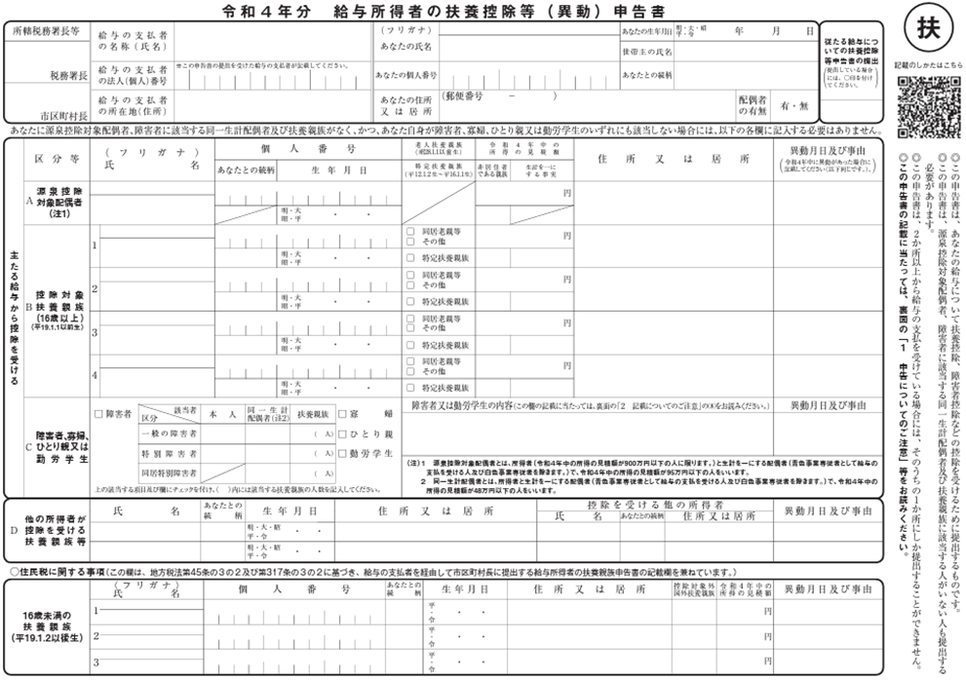
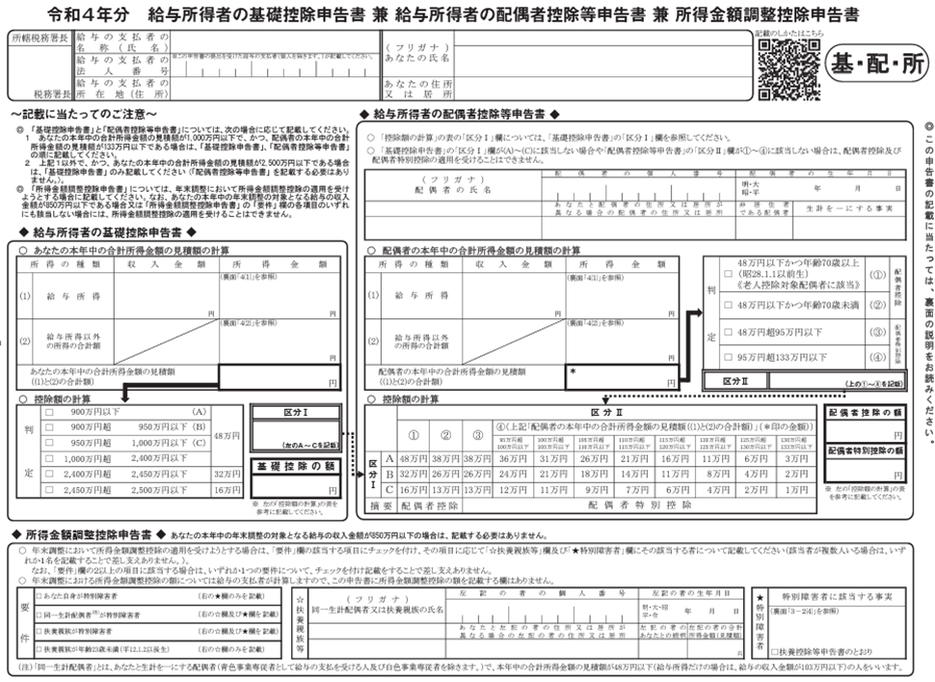
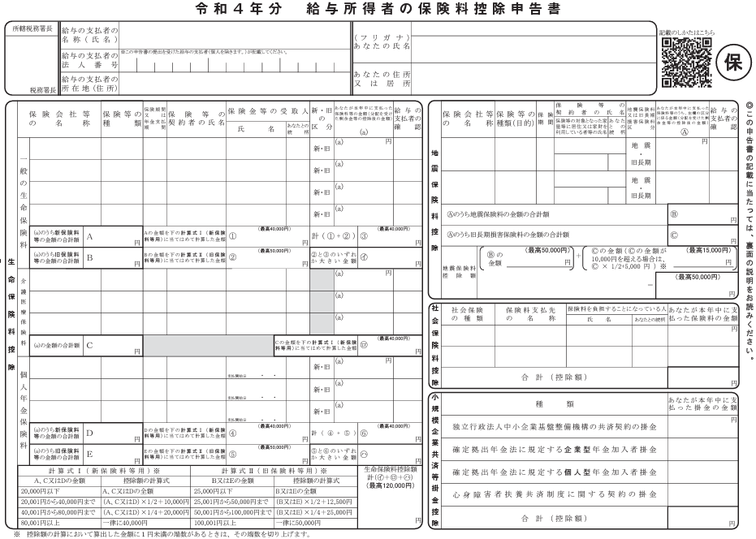
Documents Required for Year-end Tax Adjustments
▼Documents required by law to be submitted
▼Documents that must be submitted to receive the deduction
(1)(2)
(3)
(4)
Dependent Deduction (Change) Declaration Form for Current Year and Next Year (2 Copies)
Base / Distribution / Special / Office
Premium Deduction Declaration Form
Individual's income and earnings
Spouse's income and earnings
Relative' income and earnings, etc.
Life insurance premiums
Earthquake insurance premiums
iDeCo contributions, etc.
Spouse information
dependent relatives
persons with disabilities / Working students, etc.

Slide 14
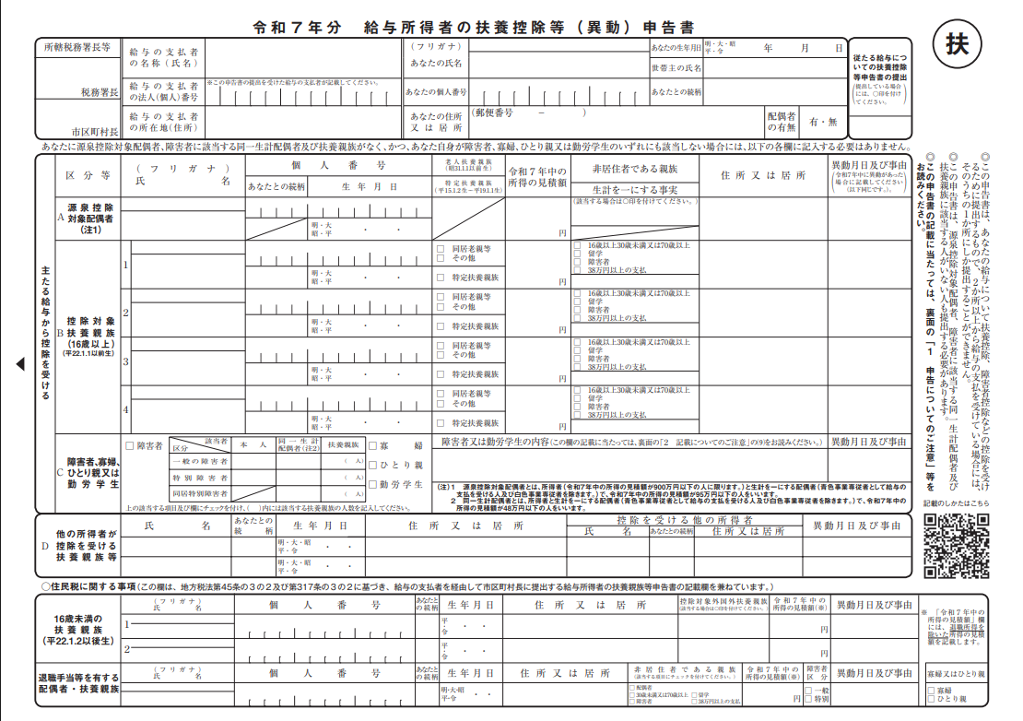
(1) Year 2025 Declaration Form for Dependent Deductions, etc. (Change) for Salaried Employees
Spouse information
dependent relatives
persons with disabilities, Working students, etc.

Slide 15
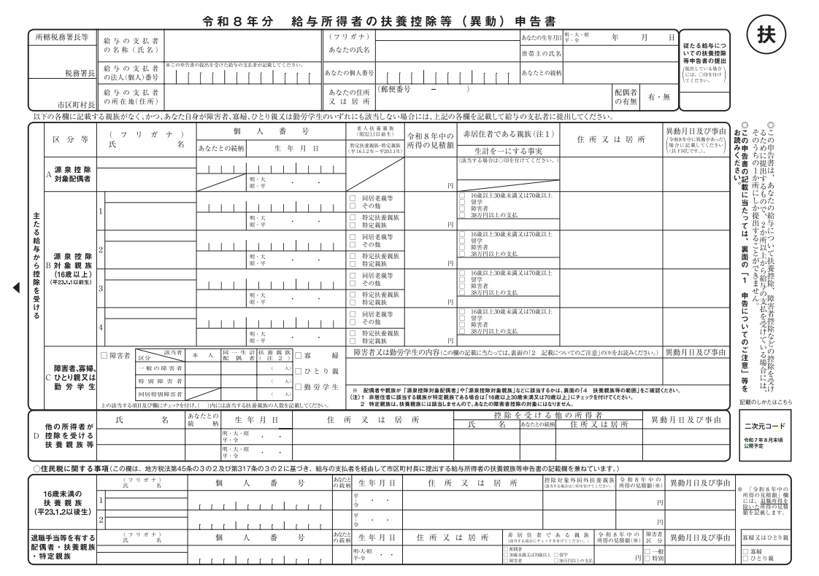
(2) Year 2026 Declaration Form for Dependent Deductions, etc. (Change) for Salaried Employees
Spouse information
dependent relatives
persons with disabilities, Working students, etc.

Slide 16
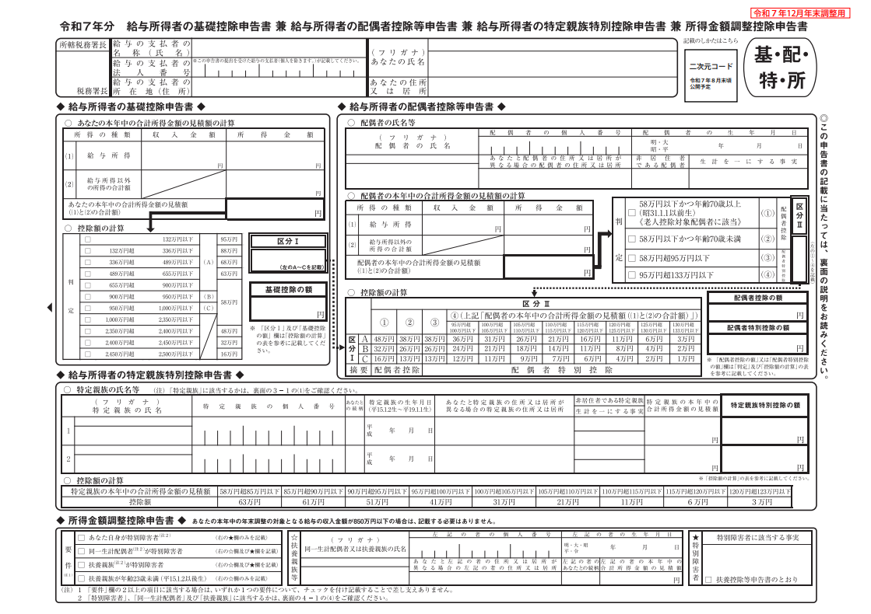
(3) Basic Deduction Declaration Form, Spouse Deduction Declaration Form, Specific Relative Special Deduction Declaration Form, and Income Amount Adjustment Deduction Declaration Form
Individual's income and earnings
Spouse's income and earnings
Relative' income and earnings, etc.

Slide 17
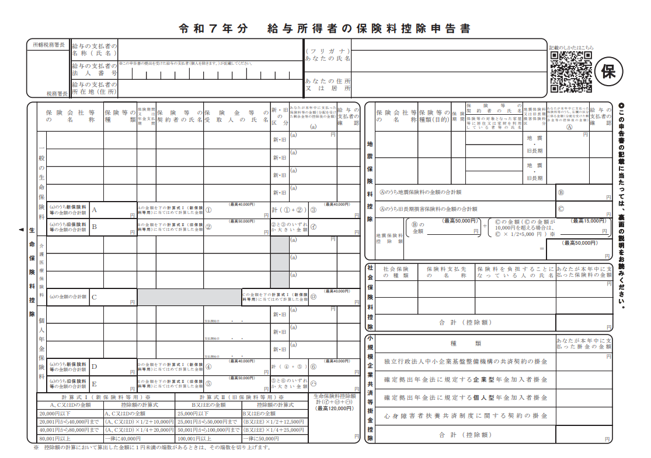
(4) Premium Deduction Declaration Form
Life insurance premiums
Earthquake insurance premiums
iDeCo contributions, etc.

Slide 18
Contents
☑ Schedule of the Year-end Tax Adjustment
☑ What is Year-end Tax Adjustment?
☑ Before Starting Year-end Tax Adjustments (preparation before input)
☑ Explanation of Each Survey Question
☑ Flow After Completing the Survey
（How to handle correction requests, how to verify withholding tax statements, etc.）
☑ Frequently Asked Questions About Employee Surveys

Slide 19
Year-End Adjustment Process
October
November
December
January
ｃ
Preparing the Tools
Notification to Employees
Tax Return Document Review
Submission of Documents to Government Offices
Conduct Information Gathering Among Employees
Actuarial
Surplus or Deficit
Manager
ｃ
employee
Response to Deduction Declaration Forms
Receipt of Withholding Statement
Verification of Surplus or Deficit

Slide 20
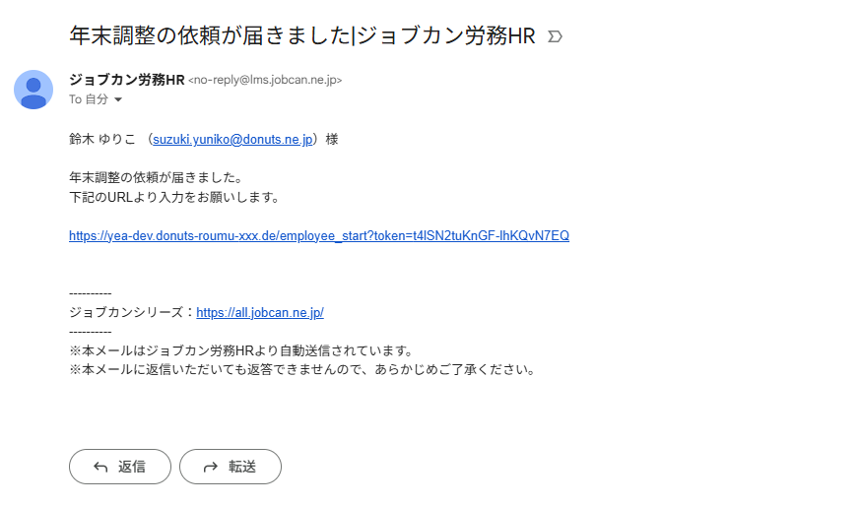
【Image】Year-End Adjustment Email Notification Screen
提出期日：2025年12月15日

Slide 21
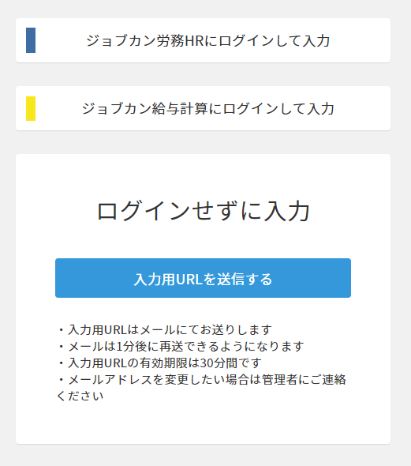
【Image】Page displayed after clicking the URL

Slide 22
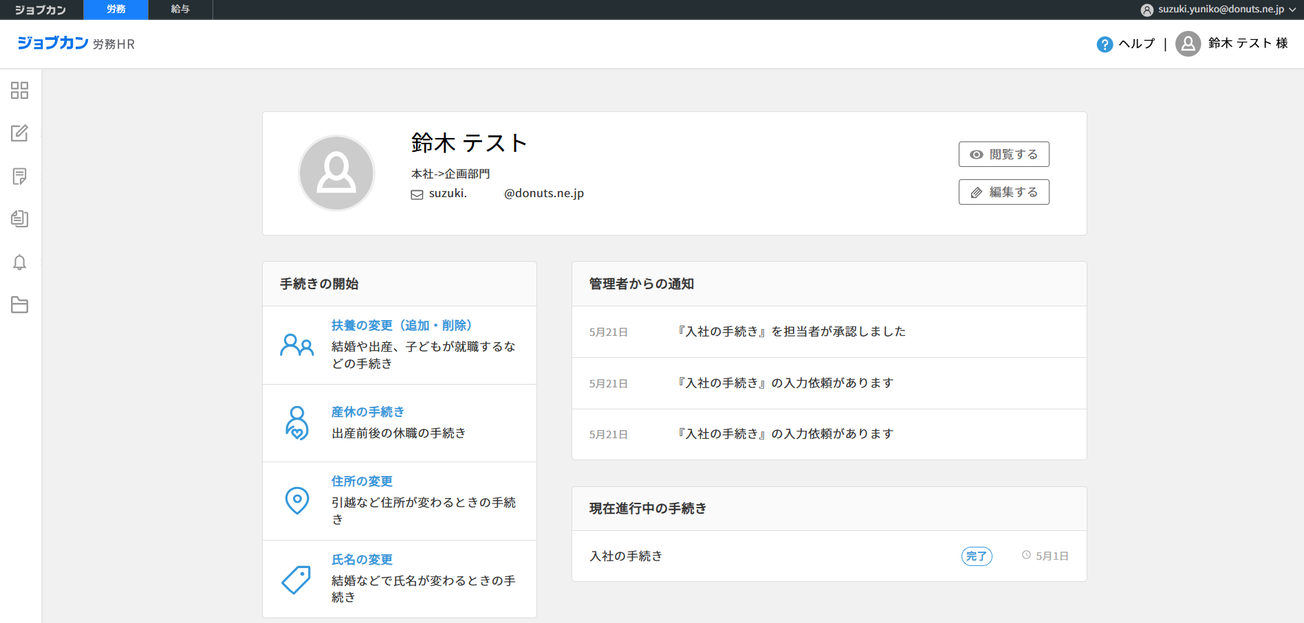
【Image】Request Notification for Employee My Page
nen
10月1日
年末調整の入力依頼があります

Slide 23
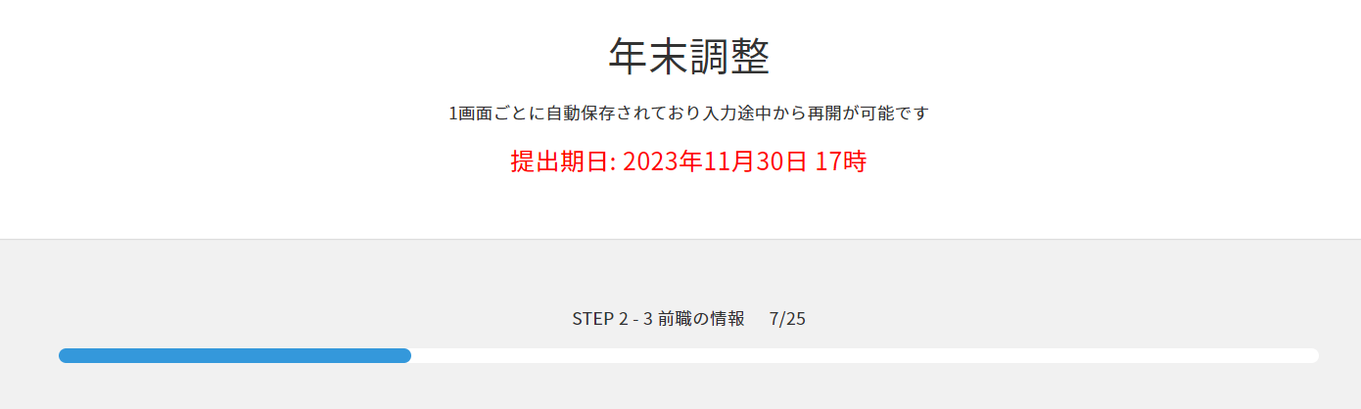
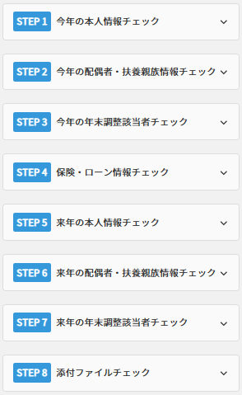
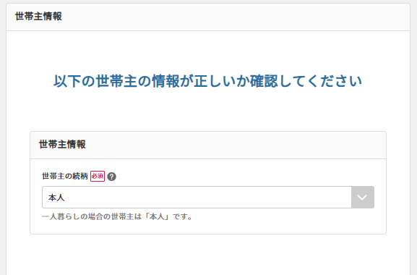
Year-End Adjustment SurveyResponses
提出期日：2025年12月15日 17時
STEP 1 - 3 世帯主情報2/34

Slide 24
Year-End Adjustment Survey Questions
・STEP1 This Year's Identity Check
・STEP2 This Year's Spouse and Dependent Information Check
・STEP3 Year-End Adjustment Eligibility Check for This Year
・STEP4 Insurance & Loan Check
・STEP5 Next Year's Personal Information Check
・STEP6 This Year's Spouse and Dependent Information Check
・STEP7 Year-End Adjustment Eligibility Check for Next Year
・STEP8 Attachment Check

Slide 25
Year-End Adjustment Survey Questions
・STEP1 This Year's Identity Check
・STEP2 This Year's Spouse and Dependent Information Check
・STEP3 Year-End Adjustment Eligibility Check for This Year
・STEP4 Insurance & Loan Check
・STEP5 Next Year's Personal Information Check
・STEP6 This Year's Spouse and Dependent Information Check
・STEP7 Year-End Adjustment Eligibility Check for Next Year
・STEP8 Attachment Check
STEP1-1 Year-End Adjustment Begins
STEP1-2 Basic Information of the Individual
STEP1-3 Household Head Information
STEP1-4 Previous Employment Information
STEP1-5 Amount of Income/Earnings
STEP1-6 Amount of Income/Earnings
STEP1-7 Working Student Information
STEP1-8 Disability Information

Slide 26
Year-End Adjustment Survey Questions
・STEP1 This Year's Identity Check
・STEP2 This Year's Spouse and Dependent Information Check
・STEP3 Year-End Adjustment Eligibility Check for This Year
・STEP4 Insurance & Loan Check
・STEP5 Next Year's Personal Information Check
・STEP6 This Year's Spouse and Dependent Information Check
・STEP7 Year-End Adjustment Eligibility Check for Next Year
・STEP8 Attachment Check
STEP2-1 Marital Status
STEP2-2 Spouse Information
STEP2-3 Dependent Information

Slide 27
Year-End Adjustment Survey Questions
・STEP1 This Year's Identity Check
・STEP2 This Year's Spouse and Dependent Information Check
・STEP3 Year-End Adjustment Eligibility Check for This Year
・STEP4 Insurance & Loan Check
・STEP5 Next Year's Personal Information Check
・STEP6 This Year's Spouse and Dependent Information Check
・STEP7 Year-End Adjustment Eligibility Check for Next Year
・STEP8 Attachment Check
STEP3-1 Year-end Tax Adjustment
Processing Locations for This Year
STEP3-2 Planned Retirement within The Year
STEP3-3 Disaster Victim Information
STEP3-4 A/B Comparison
STEP3-5 Worked at two or more companies
STEP3-6 Comparison of Salary Income This Year

Slide 28
Year-End Adjustment Survey Questions
・STEP1 This Year's Identity Check
・STEP2 This Year's Spouse and Dependent Information Check
・STEP3 Year-End Adjustment Eligibility Check for This Year
・STEP4 Insurance & Loan Check
・STEP5 Next Year's Personal Information Check
・STEP6 This Year's Spouse and Dependent Information Check
・STEP7 Year-End Adjustment Eligibility Check for Next Year
・STEP8 Attachment Check
STEP4-1 Life Insurance
STEP4-2 Earthquake Insurance
STEP4-3 National Pension and
National Health Insurance Premiums
STEP4-4 Small Business Mutual Aid Association Premiums
STEP4-5 Mortgage

Slide 29
Year-End Adjustment Survey Questions
・STEP1 This Year's Identity Check
・STEP2 This Year's Spouse and Dependent Information Check
・STEP3 Year-End Adjustment Eligibility Check for This Year
・STEP4 Insurance & Loan Check
・STEP5 Next Year's Personal Information Check
・STEP6 This Year's Spouse and Dependent Information Check
・STEP7 Year-End Adjustment Eligibility Check for Next Year
・STEP8 Attachment Check
STEP5-1 Basic Information for the Individual Next Year
STEP5-2 Next Year's Household Head Information
STEP5-3 Amount of Income/Earnings for Next Year
STEP5-4 Information for Working Students Next Year
STEP5-5 Information for Persons with Disabilities Next Year

Slide 30
Year-End Adjustment Survey Questions
・STEP1 This Year's Identity Check
・STEP2 This Year's Spouse and Dependent Information Check
・STEP3 Year-End Adjustment Eligibility Check for This Year
・STEP4 Insurance & Loan Check
・STEP5 Next Year's Personal Information Check
・STEP6 This Year's Spouse and Dependent Information Check
・STEP7 Year-End Adjustment Eligibility Check for Next Year
・STEP8 Attachment Check
STEP6-1 Whether or Not You Will Have a Spouse Next Year
STEP6-2 Spouse Information for Next Year
STEP6-3 Dependent Information for Next Year

Slide 31
Year-End Adjustment Survey Questions
・STEP1 This Year's Identity Check
・STEP2 This Year's Spouse and Dependent Information Check
・STEP3 Year-End Adjustment Eligibility Check for This Year
・STEP4 Insurance & Loan Check
・STEP5 Next Year's Personal Information Check
・STEP6 This Year's Spouse and Dependent Information Check
・STEP7 Year-End Adjustment Eligibility Check for Next Year
・STEP8 Attachment Check
STEP7-1 Next Year's Classification into Class A and Class B
STEP7-2 Working for Two or More Companies Next Year
STEP7-3 Comparison of Salary Income Next Year

Slide 32
Year-End Adjustment Survey Questions
・STEP1 This Year's Identity Check
・STEP2 This Year's Spouse and Dependent Information Check
・STEP3 Year-End Adjustment Eligibility Check for This Year
・STEP4 Insurance & Loan Check
・STEP5 Next Year's Personal Information Check
・STEP6 This Year's Spouse and Dependent Information Check
・STEP7 Year-End Adjustment Eligibility Check for Next Year
・STEP8 Attachment Check
STEP8-1 Attaching Files

Slide 33
Contents
☑ Schedule of the Year-end Tax Adjustment
☑ What is Year-end Tax Adjustment?
☑ Before Starting Year-end Tax Adjustments (preparation before input)
☑ Explanation of Each Survey Question
☑ Flow After Completing the Survey
（How to handle correction requests, how to verify withholding tax statements, etc.）
☑ Frequently Asked Questions About Employee Surveys

Slide 34
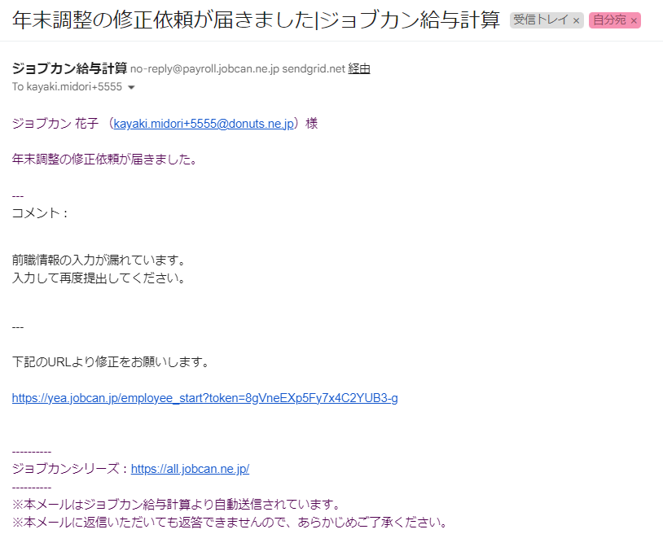
【Image】Request Revision Email

Slide 35
【Image】Page displayed after clicking the URL

Slide 36
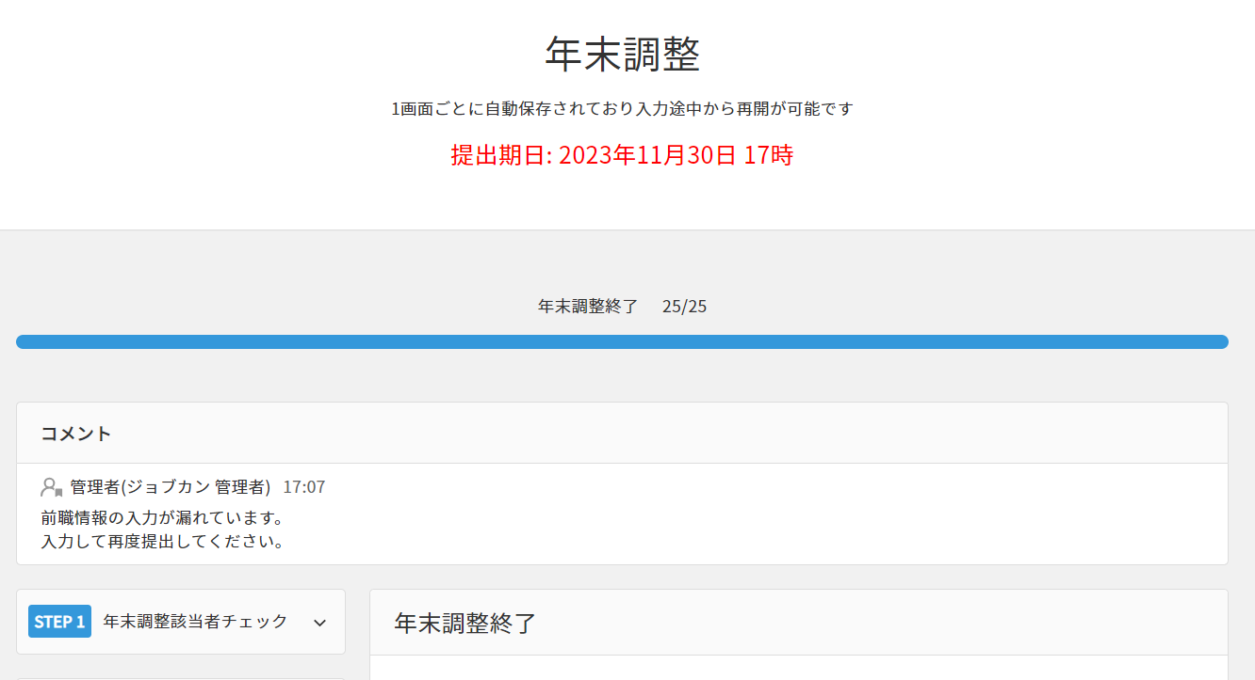
【Image】Employee Survey_Revision Request Comments

Slide 37
Year-End Adjustment Process
October
November
December
January
ｃ
Preparing the Tools
Notification to Employees
Tax Return Document Review
Submission of Documents to Government Offices
Conduct Information Gathering Among Employees
Actuarial
Surplus or Deficit
Manager
ｃ
employee
Response to Deduction Declaration Forms
Receipt of Withholding Statement
Verification of Surplus or Deficit

Slide 38
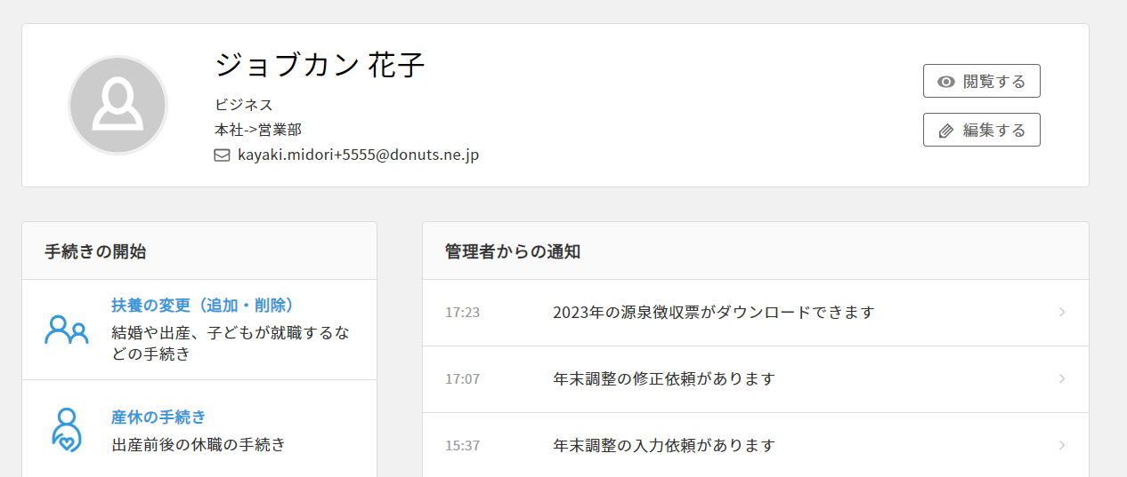
【Image】Withholding Tax Statement My Page Image
Click the notification item to download your withholding tax statement.

Slide 39
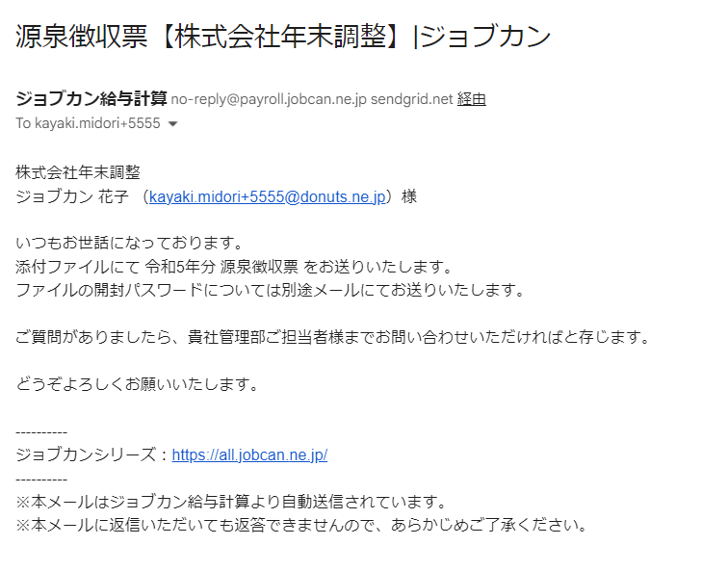
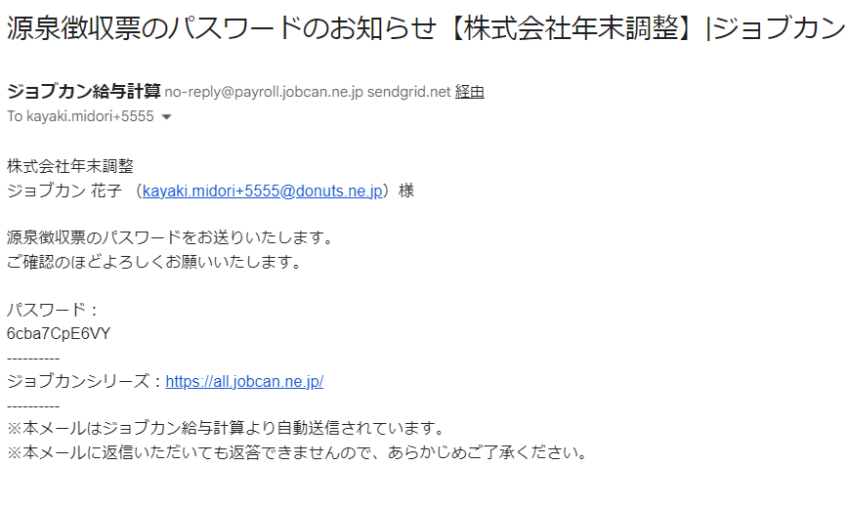
【Image】Withholding Tax Statement Email Notification

Slide 40
Year-End Adjustment Process
October
November
December
January
ｃ
Preparing the Tools
Notification to Employees
Tax Return Document Review
Submission of Documents to Government Offices
Conduct Information Gathering Among Employees
Actuarial
Surplus or Deficit
Manager
ｃ
employee
Response to Deduction Declaration Forms
Receipt of Withholding Statement
Verification of Surplus or Deficit

Slide 41
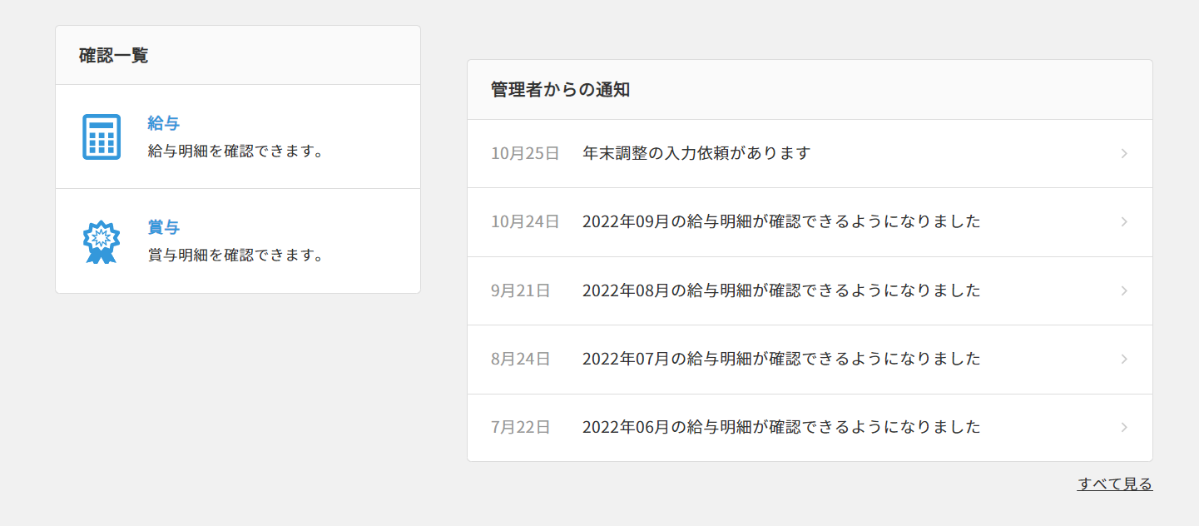
【Image】Reflected in Jobcan Payroll Calculation

Slide 42
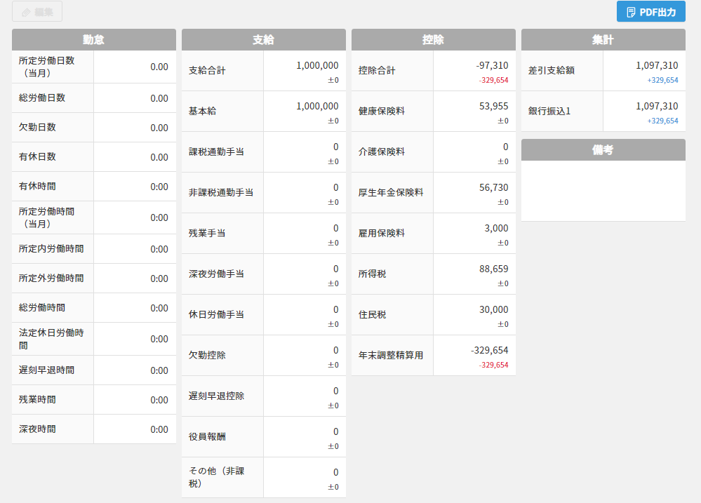
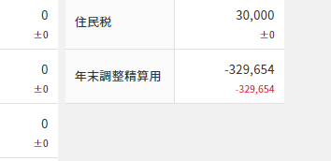
【Image】Reflected in Jobcan Payroll Calculation

Slide 43
Contents
☑ Schedule of the Year-end Tax Adjustment
☑ What is Year-end Tax Adjustment?
☑ Before Starting Year-end Tax Adjustments (preparation before input)
☑ Explanation of Each Survey Question
☑ Flow After Completing the Survey
（How to handle correction requests, how to verify withholding tax statements, etc.）
☑ Frequently Asked Questions About Employee Surveys

Slide 44
Frequently Asked Questions
Q. I submitted my entry with an error. Can I correct it?
A. Once you submit your response, you cannot modify it from the employee side. Please contact your company's designated representative.
Q. Can I respond from a smartphone or feature phone instead of a PC?
A. You can respond from a smartphone.For feature phones, you can respond if it runs Android.If you don't have a compatible device, please consult your company representative.
Q. I haven't received the survey input request email. What should I do?
A. Survey input request emails are sent from one of the following addresses:
・no-reply@lms.jobcan.ne.jp
・no-reply@payroll.jobcan.ne.jp
Please check your spam folder to see if it was filtered there.
If you still cannot find it, please contact your company's designated representative.

Slide 45
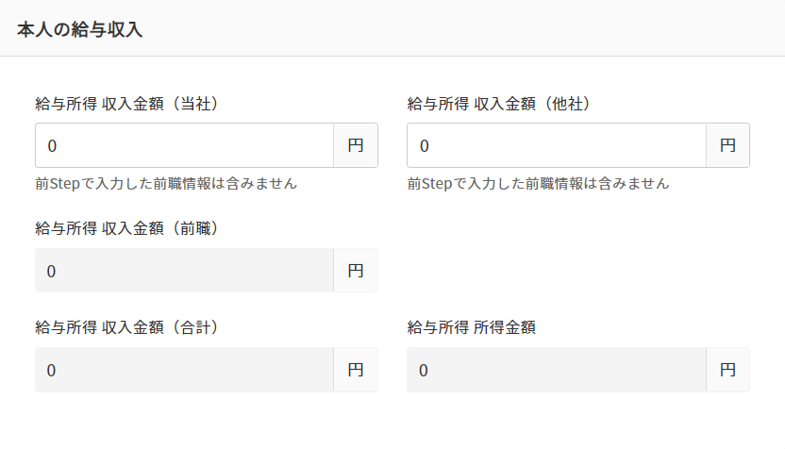
Frequently Asked Questions
Q.STEP1-6 Regarding questions about salary income
My annual income amount is not yet finalized. How should I enter the amount?
A.Since you are entering your projected annual income amount (including bonuses, excluding previous employment), please enter the projected amount through the end of December based on your pay stubs or similar documents.

Slide 46
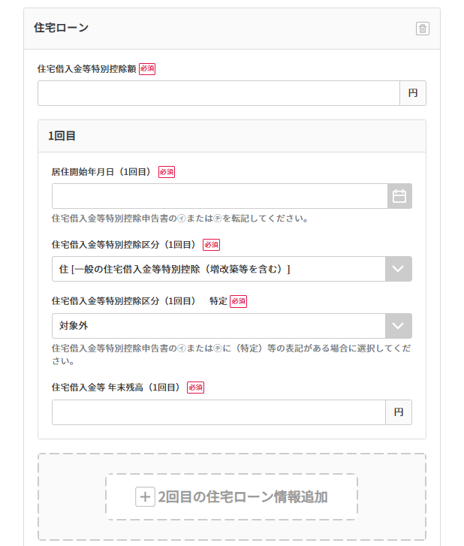
Frequently Asked Questions
Q.STEP4-5 Regarding the Home Mortgage Interest Deduction
Is this where I select the number of years since starting the special deduction for home acquisition?
A. This is where you select the number of times you have received the home loan deduction. Only if you have applied for the “Special Deduction for Home Loans, etc.” multiple times should you enter the number of times you applied.

Slide 47
Frequently Asked Questions
Q.STEP4-5 Regarding the Home Mortgage Interest Deduction
Is this where I select the number of years since starting the special deduction for home acquisition?
A. This is where you select the number of times you have received the home loan deduction. Only if you have applied for the “Special Deduction for Home Loans, etc.” multiple times should you enter the number of times you applied.

Slide 48



This year's year-end tax adjustments are a breeze with Jobcan!

